Slide 1
Marketing Measurement Triangulation
5th May 2025
Santhosh D M

Slide 2


Agenda
MM Components, Pros and Cons
Methodology for Triangulation and Examples
Scenario Planning and Budget Optimisation
Timeline Plan

Slide 3
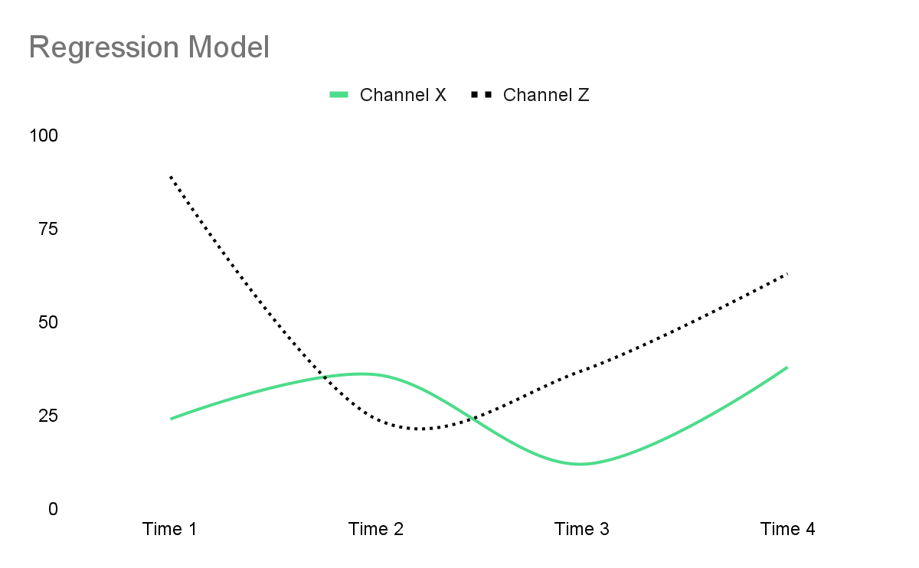
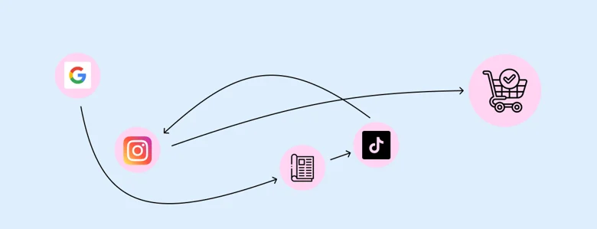
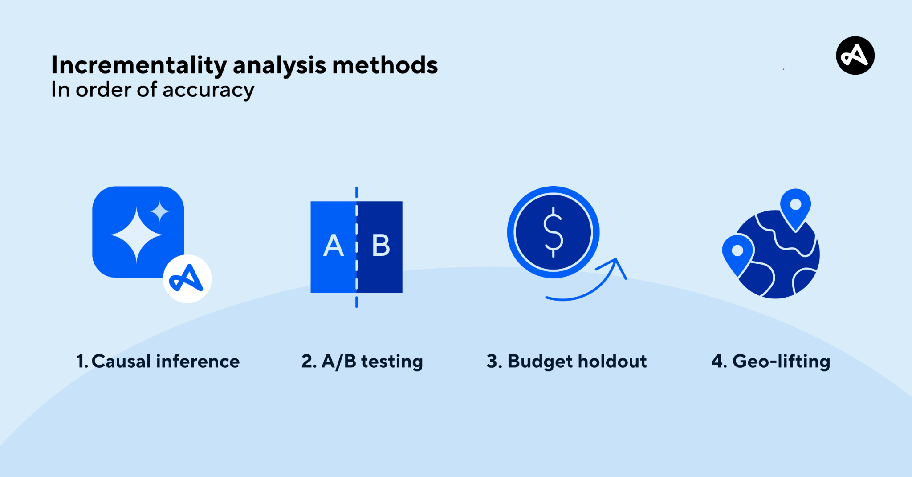
MM Components, Pros and Cons
Aspect | MMM | MTA | Incrementality Testing
Purpose | Measure aggregate impact | Attribute credit across digital touchpoints | Prove causal impact of a campaign
Best For | Long-term planning, offline media | Tactical digital optimization | Validating true lift from campaigns
Data Needs | spend, media, sales, and external factor data | User-level journey and conversion data | Test/control setup (geo splits, holdouts).
Refresh Speed | Quarterly or monthly | Daily or weekly updates | Per experiment
Strengths | Captures macro & offline effects, ROI | High granularity, Near real-time | Gold standard causality
Limitations | Slow refresh, Not granular & High data needs | Ignores offline, Attribution bias & Requires tracking | Costly & Setup complexity
Answers | “What worked over time and how much should I invest?” | “Which touchpoints in the journey mattered most?” | “Would sales have happened without this ad?”

Slide 4
Methodology for Blending MTA, MMM & Incrementality Testing
1. Establish a Common Baseline with Incrementality Testing
Steps:
1. Run Initial Holdout Tests
Exclude 50% of users from Paid Social for 2 weeks.
2. Measure True Incremental Lift
If Paid Social results in 12% incremental conversions, but MTA attributed 25%, the incrementality factor = 12/25 = 0.48.
3. Adjust MTA Attribution
- Scale Paid Social’s MTA contribution down by 52%: - Adjusted_Share = MTA_Share × (Lift / MTA_Share)
- Re-normalize attribution shares across all channels to total 100%.
4. Update MMM Inputs or Coefficients
If Paid Social’s MMM beta was 1.66 with a 2.8% contribution, but true lift is 1.4%:
Adjusted Beta = 1.66×(1.4/2.8)=0.832
Output: Calibration factors for MTA & MMM (e.g., "Reduce Paid Social credit by 52% in MTA").

Slide 5
2. Deploy Multi-Touch Attribution (MTA) with Incrementality Adjustments
How to Blend with Incrementality?
Implement Algorithmic Attribution (Shapley/Markov)
Analyze user-level paths (e.g., Paid Social → Display → Conversion).
Apply Incrementality Corrections
If Paid Social’s holdout test shows 12% lift, but MTA credits it with 25% of conversions, reduce its weight in the model.
Output: Refined digital attribution that accounts for true incrementality.

Slide 6
3. Build Marketing Mix Modeling (MMM) Anchored by Test Results
How to Blend with Incrementality & MTA?
1. Input Data Requirements
2. Calibration Steps
Step 1: Validate Offline Channels (TV/Radio)
Data Source | What It Provides | Examples
Incrementality Tests(IT) | Ground-truth lift per channel | TV: +15% sales lift (geo test)
MTA | Digital channel contribution paths | Display: 20% assisted conversions.
MMM (Initial Model) | Baseline coefficients | Paid Search coef: 1.2, TV coef: 0.7, Display coef: 0.4
Action | Formula | TV Example
Compare MMM estimate vs. IT | Adjustment Factor = (Test Lift) / (MMM Predicted Lift) | 15% (test) / 10% (MMM) = 1.5x
Update MMM coefficient | New Coef = Original Coef × Adjustment Factor | 0.7 (original) × 1.5 = 1.05

Slide 7
Step 2: Calibrate Digital Channels (Paid Search, Display)
MTA shows Display assists 20% of conversions.
Step 3: Model Cross-Channel Effects
TV → Branded Search Conversions
Observations:
MTA shows 25% of conversions include path: TV → Branded Search
Search query data: 40% lift in branded searches during TV campaigns – Further validate using Granger Causality/CCF test
Action | Formula | Display Example
Compare MTA vs. MMM attribution | Discrepancy Ratio = (MTA % Attribution) / (MMM % Contribution) | 20% (MTA) / 8% (MMM) = 2.5x
Adjust MMM digital coefficients | New Coef = Original Coef × Discrepancy Ratio | 0.4 (original) × 2.5 = 1.0

Slide 8
Model Cross-Channel Effects
1. Calculate TV's indirect impact on Paid Search:
TV's Search Influence = (TV Coef) × (% of branded searches from TV) = 0.70 × 0.25 = 0.175
2. Update Paid Search coefficient to avoid double-counting:
New Paid Search Coef = Original Coef - TV's Search Influence = 1.20 - 0.175 = 1.025
3. Increase TV coefficient to capture full value:
New TV Coef = Updated TV Coef from IT + TV's Search Influence = 1.05 + 0.175 = 1.225
Output: Holistic budget allocation balancing short-term (MTA) and long-term (MMM) effects.
Why this is important?
Prevents overcounting Paid Search performance
Captures TV's true halo effect on digital channels
Channel | Original Coef | Adjusted Coef
TV | 0.7 | 1.225
Paid Search | 1.2 | 1.025

Slide 9
Marketing Measurement Triangulation Summary Table
Updated Coeff/Contribution Summary Table
Marketing Measurement Triangulation Summary Table
Component | Method | Example | Adjustment Formula | Output
Offline Channels(TV, Radio) | Incrementality Tests | TV geo test: 15% lift vs MMM's 10% prediction | New Coef = Original Coef × (Observed Lift / Predicted Lift) | TV coef: 0.7 → 1.05 (+50%)
Online Channels(P.S, Display) | MTA + Incrementality | Paid Social: 12% lift (test) vs 25% MTA attribution | New Weight = MTA Weight × (Incrementality / MTA Attribution) | Paid Social: 25% → 12% (-52%)
Cross-Channel Effects | Blended MTA+MMM | TV drives 25% of branded searches (MTA) | TV Coef += (Paid Search Coef × % Assisted) | TV: 1.05. → 1..225
 |  |  | Paid Search Coef -= (TV Coef × % Assisted) | Paid Search: 1.2 → 1.025
Channel | Original | Calibrated | Rationale
TV | Coef: 0.70 | Coef: 1.225 | Geo test showed 15% lift & Attributed incrementals from Paid Search
Paid Search | Coef: 1.20 | Coef: 1.025 | Adjusted for TV’s branded search influence
Paid Social | MTA: 25% | MTA: 12% | Holdout test showed only 12% incrementality
Display | Coef: 0.40 | Coef: 1 | Corrected for MTA

Slide 10
General Framework for Triangulation
1. Offline /Online Channels (TV, Radio, DOOH, Print)
Method: Incrementality Lift Tests
Adjusting MMM: New Offline Coef = Original Coef × (Observed Lift / Predicted Lift)
Example: TV predicted 10% sales lift → Test shows 15% → Adjust coefficient by +50%
2. Online Channels (Paid Search, Social, Display, Affiliate)
Method: Multi-Touch Attribution (MTA)
Examples: Fair credit across Paid Social → Display → Conversion paths
3. Adjusting MMM: Digital Coef Adjustment = (MTA Attribution % / MMM Contribution %)
Example: MTA says Display drives 20% conversions → MMM says 12% → Adjust coefficient ×1.67

Slide 11
Start
Run Incrementality Test
- Test Group, Control Group
- t-test
Run MTA
MTA - Marko Model
Offline/Online Channels
Run MMM
Online Channels
- Bayesian Regression-PyMC
Triangulate-IT,MMM,MTA
- Adjust MMM coef. based on IT & MTA insights
- Update priors and rerun MMM
End

Slide 12
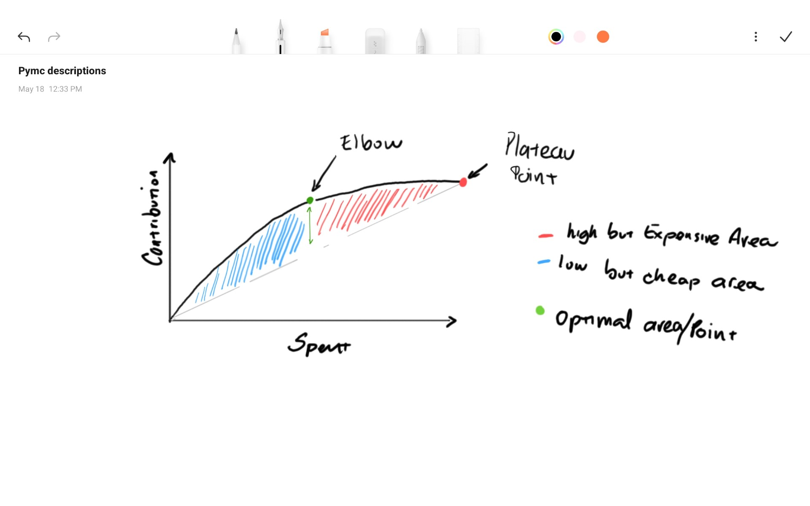
Scenario Planning and Budget Optimisation
Objective: To determine the optimal budget allocation across channels to maximize return on investment (ROI) and achieve business goals.
Optimization techniques -
Linear Programming and PyMC
Response Curves - Optimising mROI
Scenario planning - Best-case, worst-case, and realistic scenarios simulations
Test different spend scenarios and evaluate sales growth impact.

Slide 13
Timeline Plan for MM Triangulation
Gantt Chart
Phase | Week 1 | Week 2 | Week 3 | Week 4 | Week 5 | Week 6 | Week 7 | Week 8 | Week 9 | Week 10
Experiment Design
Incrementality Test
Analyze Incrementality Results
MTA Path Analysis
MMM Modeling
Triangulation & Calibration
Final Decision & Rollout

Slide 14
Thank you

